Slide 1


rakirahman.me
Hi, I’m Raki.
I build Big Data & AI Solutions on Microsoft Azure.

Slide 2


rakirahman.me
Hey look,
IT’S A BLOG!

Slide 3




rakirahman.me
BLOGGING WITH
on Azure

Slide 4
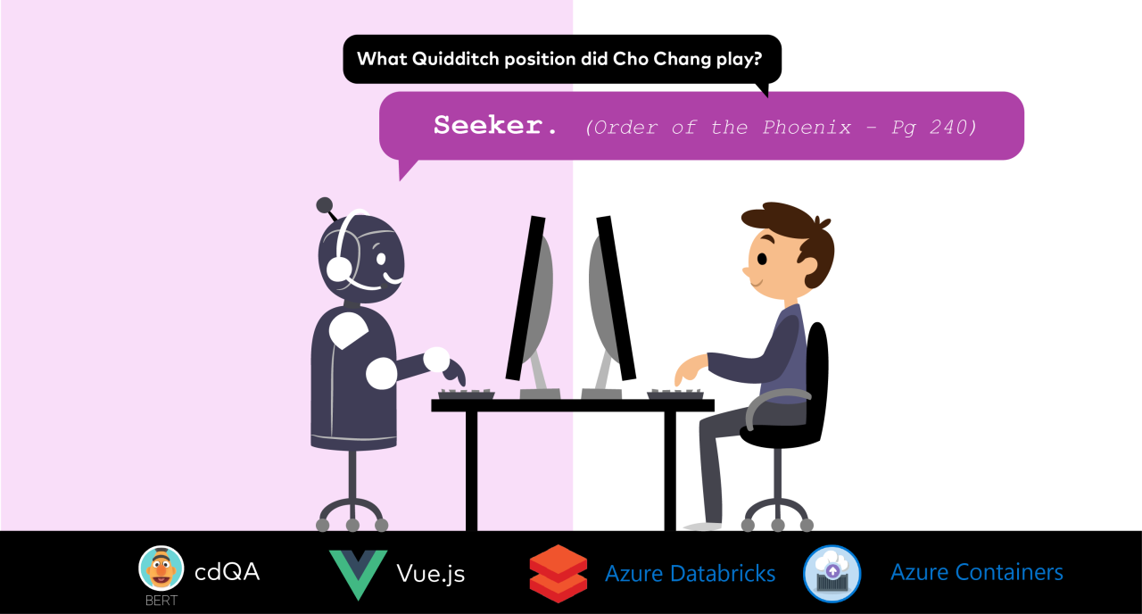
rakirahman.me

Slide 5


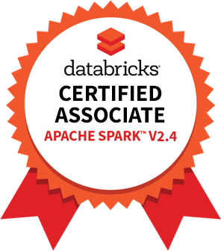

rakirahman.me
PART 1
COMPREHENSIVE
STUDY GUIDE

Slide 6
rakirahman.me
PART 2
COMPREHENSIVE
STUDY GUIDE

Slide 7

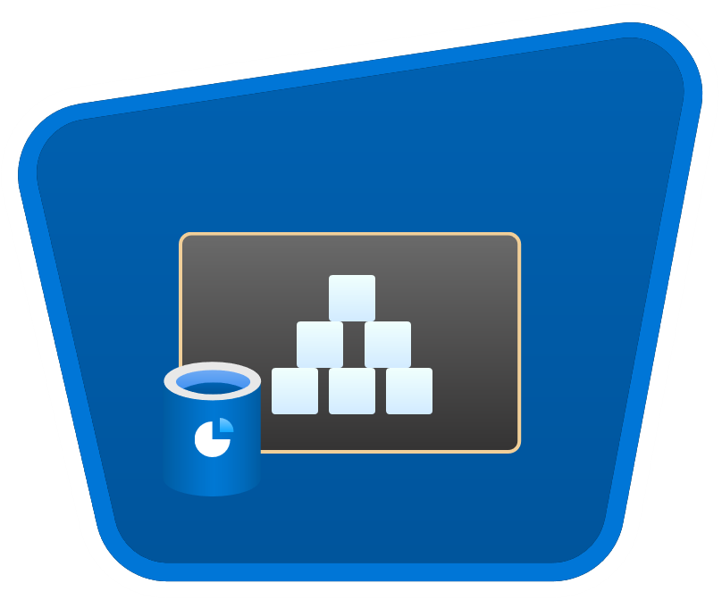




rakirahman.me
AUTOMATING
to Synapse
with Autoloader

Slide 8

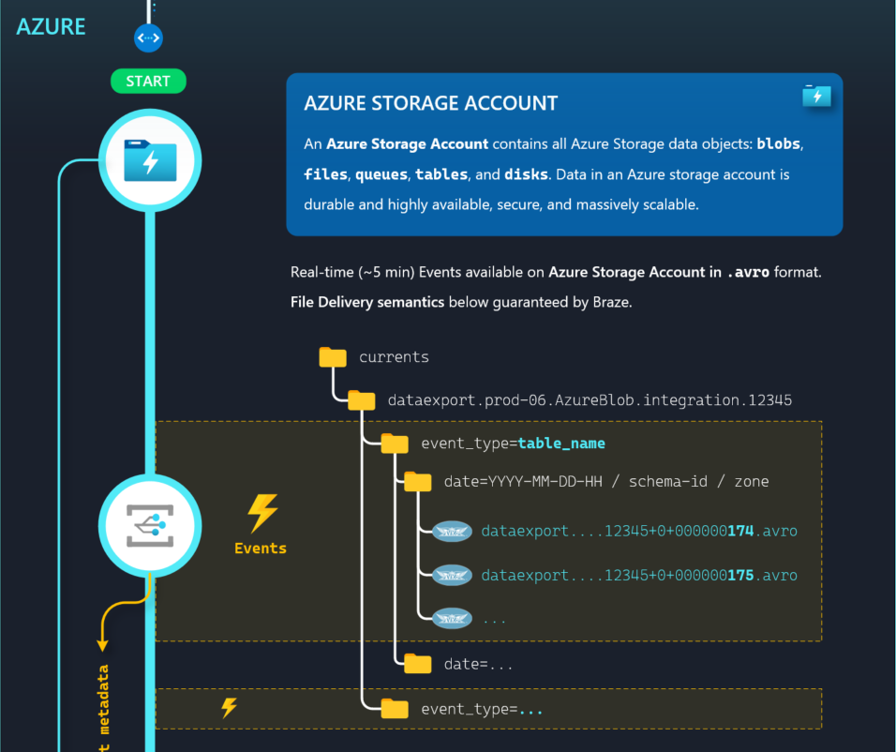
ILLUSTRATION
to Synapse
with Autoloader

Slide 9
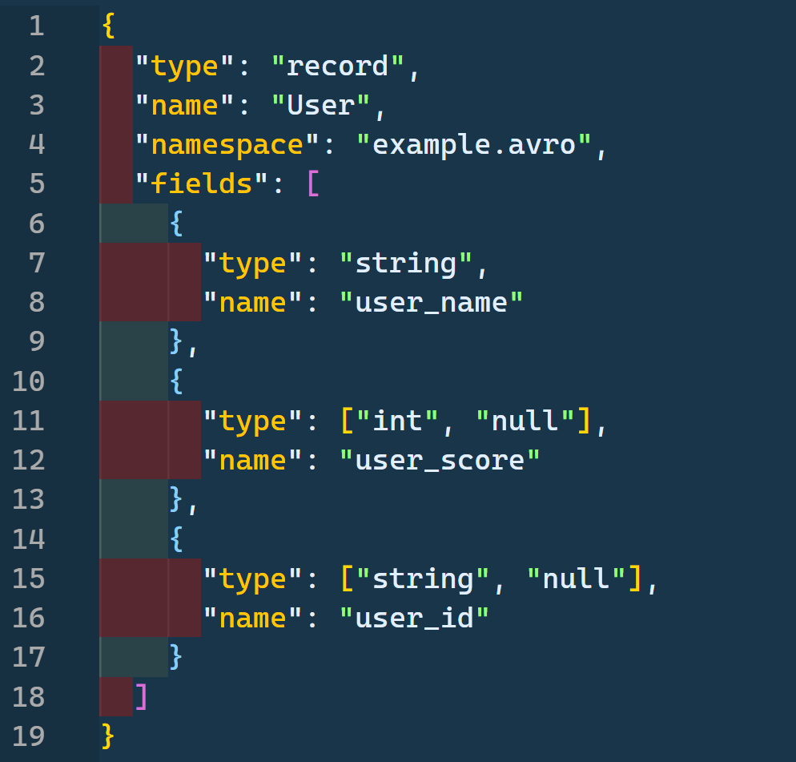

Exploring Azure Schema Registry with

Slide 10
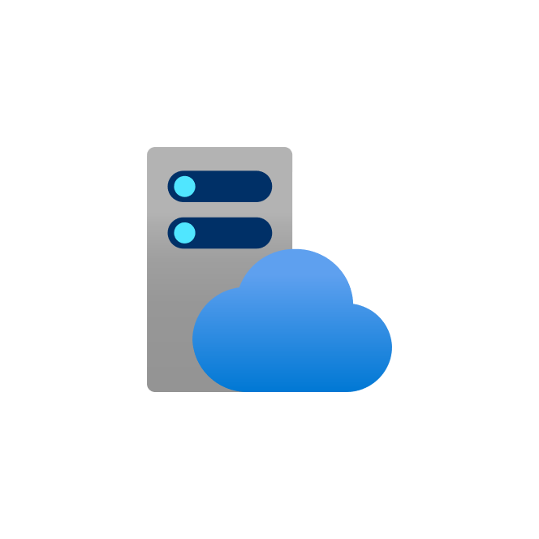

rakirahman.me
PACKING
DENSITY
PREMIUM
MAXIMIZING
App Service Plan
AZURE FUNCTIONS

Slide 11
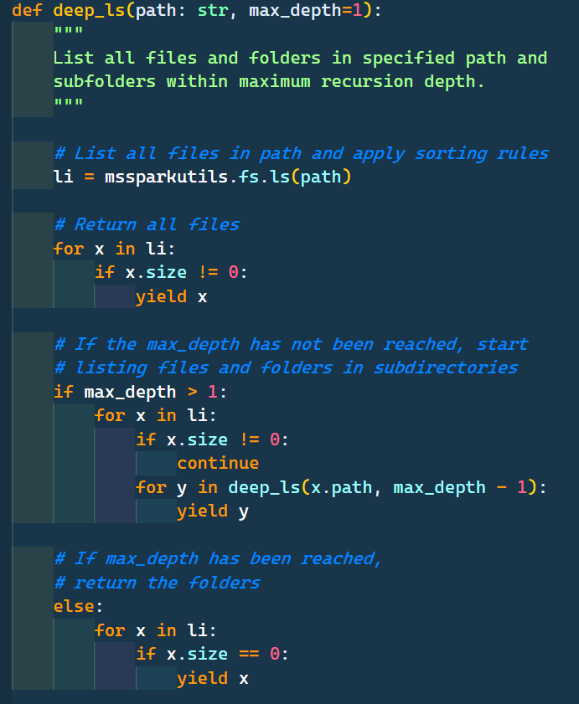
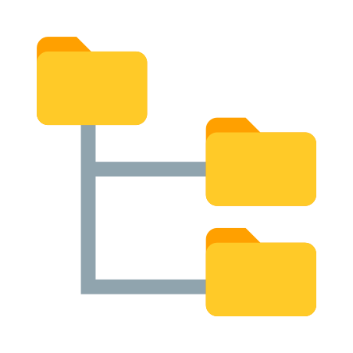






Slide 12
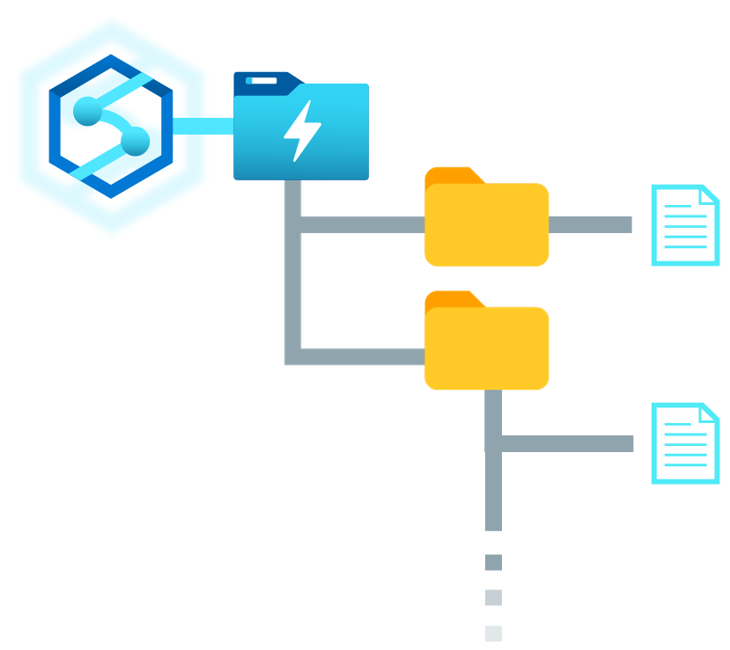
How to Recurse through Data Lake Folders with
Synapse Spark Pools

Slide 13

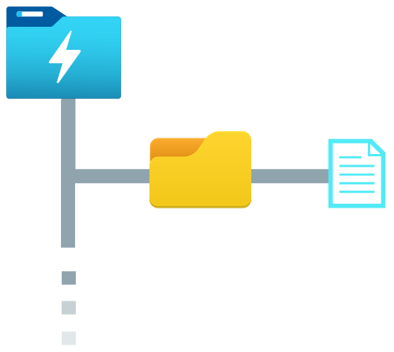


Purview
Synapse
Column name
Classifications
filename
asset
schema
email
Email Address
CashFlow_01.csv
CashFlow_{N}.csv
0: email, PERSONAL.EMAIL
1: creditcard, FINANCIAL.CREDIT_C...
2: creditcardtype, NULL
3: amount, NULL
creditcard
Credit Card Number
REST API
CashFlow_01.csv
creditcardtype
amount
Sales_02.parquet
Sales_{N}.parquet
[["ip_address","PERSONAL.IPADDRES...
CashFlow_{N}.csv
Profit_01.json
Profit_{N}.json
"[["id",null],["IBAN",“FINANCIAL...
Spark DataFrame
Exploring Purview’s API: accessing asset classifications in Synapse

Slide 14
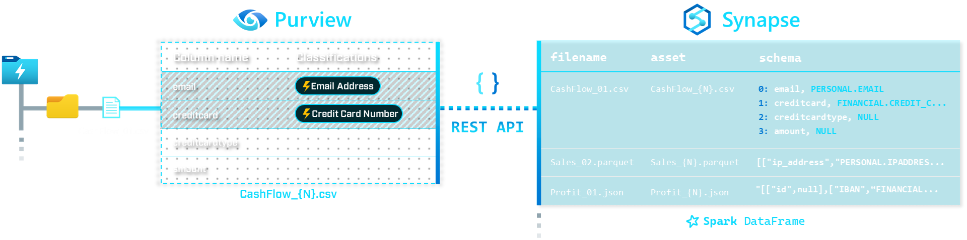
Exploring Purview’s REST API
with Synapse

Slide 15
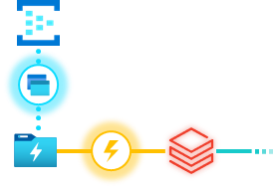
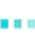
Stream Processing Event Hub Capture files
with Auto Loader

Slide 16

Azure Synapse Analytics
Designed for analytics workloads at any scale
Limitless analytics service with unmatched time to insight
SaaS developer experiences for code free and code first
Artificial Intelligence / Machine Learning / Internet of Things
Intelligent Apps / Business Intelligence
Synapse Analytics
Multiple languages suited to different analytics workloads
Experience
Azure Synapse Studio
Platform
Integrated analytics runtimes available provisioned and serverless on-demand
SQL Analytics offering T-SQL for batch, streaming and interactive processing
Spark for big data processing with Python, Scala, R and .NET
MANAGEMENT
Languages
MANAGEMENT
SQL
Python
.NET
Java
Scala
R
SECURITY
Form Factors
SECURITY
PROVISIONED
SERVERLESS
MONITORING
Analytics Runtimes
MONITORING
SQL
METASTORE
METASTORE
DATA INTEGRATION
Azure
Data Lake Storage
Integrated platform services for, management, security, monitoring, and metastore
Common Data Model
Enterprise Security
Optimized for Analytics
Data lake integrated and Common Data Model aware

